Slide 1
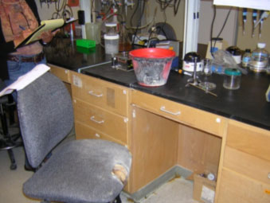
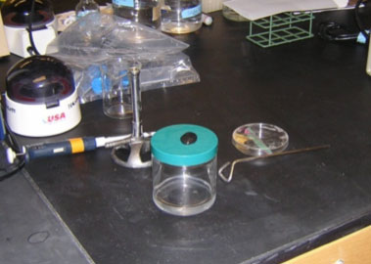
Biological Sterilization – Ethanol and Open Flame
Only fill container with minimal amounts
Keep alcohol container at least 12 inches from burner
Cap alcohol container between uses to avoid spills
In case of fire, immediately use safety shower to prevent serious burns
http://ehs.berkeley.edu/hs/129-lessons-learned-at-uc-berkeley/289-ethanol-fire-burns-researcher.html

