Slide 1
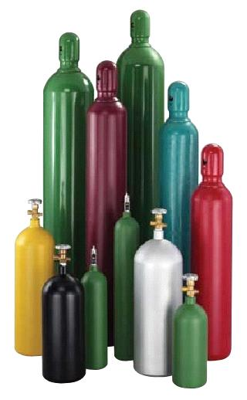
Compressed Gas Cylinder Safety
Make sure cylinders are chained and secured properly.
Do not chain multiple cylinders with the same chain.
Ensure the cylinder cap is securely fastened when tank is not in use.
Make sure regulator is cleaned and labeled for proper use with the gas in question.
Check for leaks after setting up a new cylinder.

