Slide 1
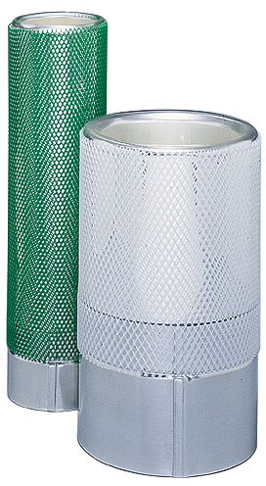
Glass Dewar Safety
Dewar flasks are under vacuum.
Shield flasks with friction tape or enclose with plastic mesh to reduce the risk of flying glass.
Use metal flasks if there is a significant possibility for breakage.
Remember, contents of the flask will be extremely cold so all safety precautions involving cryogenic liquids should also be observed.

