Slide 1
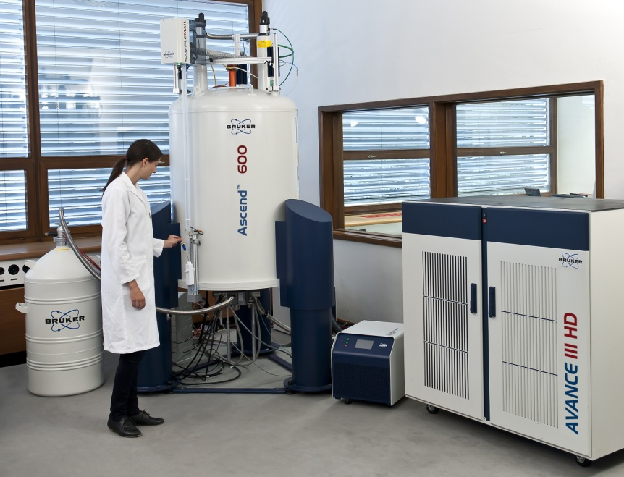
NMR Safety
Unshielded NMR instruments have enough of a magnetic field to attract large objects when brought close.
The magnetic field can also cause medical implants to malfunction.
NMR instruments use cryogenics such as liquid nitrogen and liquid helium so all safety procedures pertaining to cryogenic liquids should also be observed.

