Slide 1
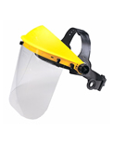
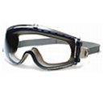
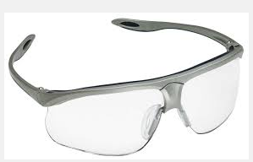
Types Of Eye Protection
Eye Protection Required | Operation
Safety Glasses – Side Shields are impact resistant frames | Entering lab or liquid chemical area where the probability of eye injury exists
Chemical Splash Goggles – indirect ventilation for splash protection | Handling corrosive chemicals
Splash goggles and face shield – additional face coverage | Transferring large quantites of corrosive chemicals
Prescription safety glasses available at no cost with valid eyeglass prescription
Contact lenses offer no protection
Image source: http://www.orcbs.msu.edu/chemical/programs_guidelines/ppe_program/eye_face/eye_face.htm

