Slide 1
Candidacy Process
Autumn 2023
Dr. Zachary Schultz, Vice Chair for Grad. Studies
Department of Chemistry and Biochemistry

Slide 2
Candidacy Exam Overview
Written and oral portions
Written exam is a proposal, all in your own words, one independent aim
Oral exam is a general exam
Must advance by end of spring second year (or third with MS)
Rubric – review early (Candidacy Rubric)
Template is available (Candidacy Proposal Template)
https://gradforms.osu.edu

Slide 3
Timeline
November 22 – Aims due to your committee
Committee should respond within 1 week
March 15 – Proposal due to your committee
Committee members should respond within 2 weeks
Proposal must be approved, exam must be scheduled, and Application for Candidacy must be submitted in Gradforms at least 2 weeks before oral exam date
May 6 – last day to schedule Exam for SP24
Copy Jennifer (Hambach.2@osu.edu) on all communications with your committee.

Slide 4
What happens if I miss the deadline?
You are on probation.
Affects advisor’s ability to support you on GRA
If not completed by Oct. 31, you are not eligible to hold an appointment in the department going forward – initiate process to dismiss you from the program.

Slide 5
Advisor Role
The entire proposal must be written by the student in her or his own words, and one Aim must be conceived independently by the student and describe a research goal that is not pursued in the student’s lab or described in the advisor’s papers or grant proposals.
The advisor should, however, limit their input on the scientific content of the proposal and the proposed ideas in general, particularly with respect to the independent aim.
…advisors are not permitted to attend or participate in these practice exams.
Advisors are expected to schedule the exam once the committee approves the proposal.

Slide 6
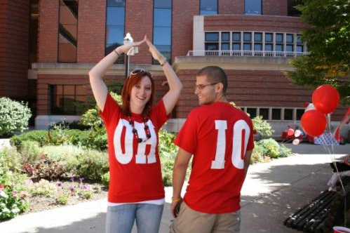
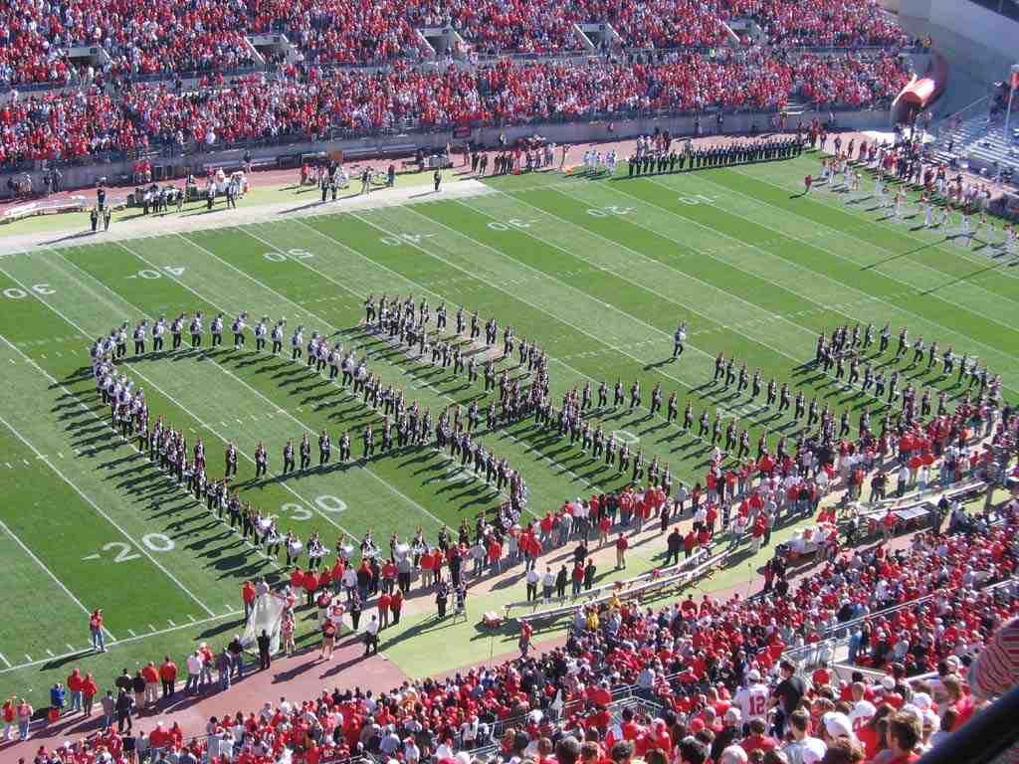
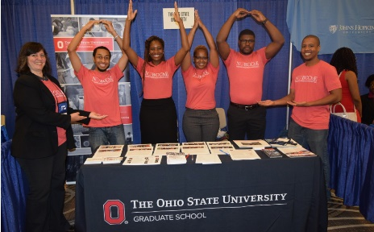
We are here to help you!
Let us answer your questions.
Zac Schultz, schultz.133@osu.edu
Jennifer Hambach, hambach.2@osu.edu or (614) 292-8917

